Slide 1
Blue Economy
By
Chowdhury Mujaddid Ahmed

Slide 2
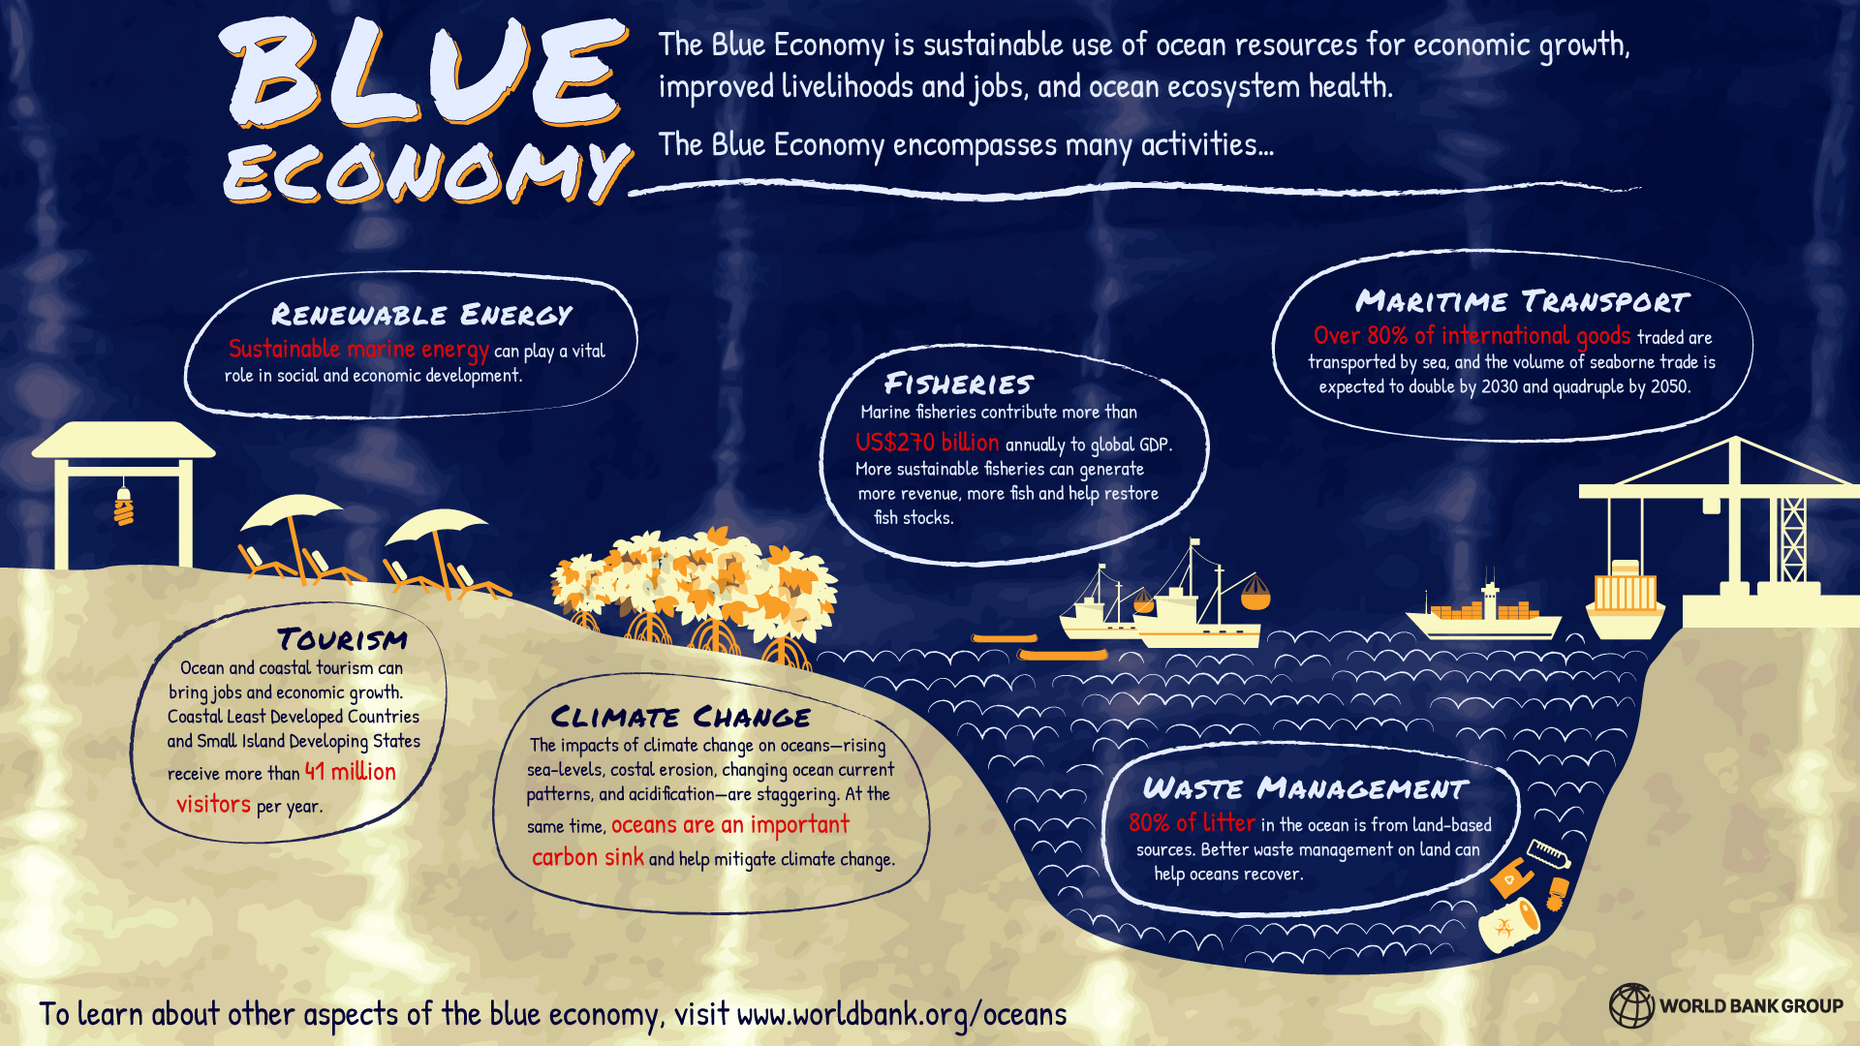
What is Blue Economy?
For more definitions

Slide 3
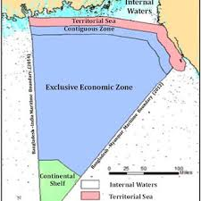
BLUE ECONOMY –DEVELOPMENT OF SEA RESOURCES FOR BANGLADESH
Framework for Sustainable Development: There is need to demonstrate measurable steps towards critical internationally agreed targets for fisheries, aquaculture, habitat protection and pollution reduction. It should also highlight the need to address the next frontiers of successful integrated approaches that include public-private partners, secure financing and catalyze good ocean governance while reconciling tensions and balancing priorities between;
  Balancing Growth and Conservation
  Balancing private sector growth and equitable benefits for communities
  iii. Uniting EEZ and Areas Beyond National Jurisdiction (ABNJ)

Slide 4
The Blue Economy – Opportunities
Shipping and Port Facilities- 80 percent of global trade by volume, and over 70 percent by value, is carried by sea and handled by ports worldwide.
Fisheries – The world has elevated recognition of the essential role of fisheries and aquaculture for food security and nutrition in the context of climate change and the employment of millions of people, many of whom struggle to maintain reasonable livelihoods, especially in the developing world.
Aquaculture- Aquaculture is the fastest-growing global food sector now providing 47% of the fish for human consumption Global fish production peaked at about 171 million tonnes in 2016.
Tourism- Marine and coastal tourism is of key importance to many developing countries. Tourism is a major global industry; International tourist arrivals grew 7.0% in 2017, the highest increase since the 2009 global economic crisis and well above UNWTO’s long-term forecast of 3.8% per year for the period 2010 to 2020.
Energy- In 2018 offshore fields accounted for more than 33% of worldwide crude oil production and this is projected to rise to 34% in 202510 and higher subsequently, as almost half the remaining recoverable conventional oil is estimated to be in offshore fields
Biotechnology and marine genetic resources- Biotechnology market size will reach USD 775.20 billion by 2024. The rising prevalence of chronic diseases has increased the demand for innovations similar to DNA sequencing, micro assays, and recombinant DNA technologies to develop therapeutic solutions.
Submarine mining- The world is gearing up for the exploration and exploitation of mineral deposits on and beneath the sea floor.

Slide 5
Development of Blue Economy in Bangladesh
The Blue Economy approach emphasized that ideas, principles, and norms of the Blue Economy lend significant contributions towards the eradication of poverty.
Contributing to food and nutrition security, mitigation and adaptation of climate change, and generation of sustainable and inclusive livelihoods.
Thus Blue Economy requires a balanced approach between conservation, development, and utilization of marine and coastal ecosystems,
All oceanic resources and services with a view to enhancing their value and generating decent employment, securing a productive marine economy and healthy marine eco-systems.

Slide 6
Sectors of Blue Economy
Maritime trade and shipping
Food and livelihood
Marine Biotechnology
Energy
Tourism
Coastal protection/Artificial islands/Greening coastal belts
Human resource and spatial planning

Slide 7
Essential reading
BLUE ECONOMY –DEVELOPMENT OF SEA RESOURCES FOR BANGLADESH by Rear Admiral Md. Khurshed Alam (Retd.)
Blue economy of Bangladesh: Prospects and challenges
The future of the Blue Economy in Bangladesh

Slide 8
Thank you
End
of
Lecture 9

